Slide 1
Star Classification
Sorting stars by their properties

Slide 2
Why Are the Stars in Orion Different Colours?
The colour of a star is determined by its ______________________.
Red stars are____________. (e.g. Betelgeuse – top left)
Blue stars are ___________.
The in-between colours are _______________________ (from coldest to hottest).

Slide 4
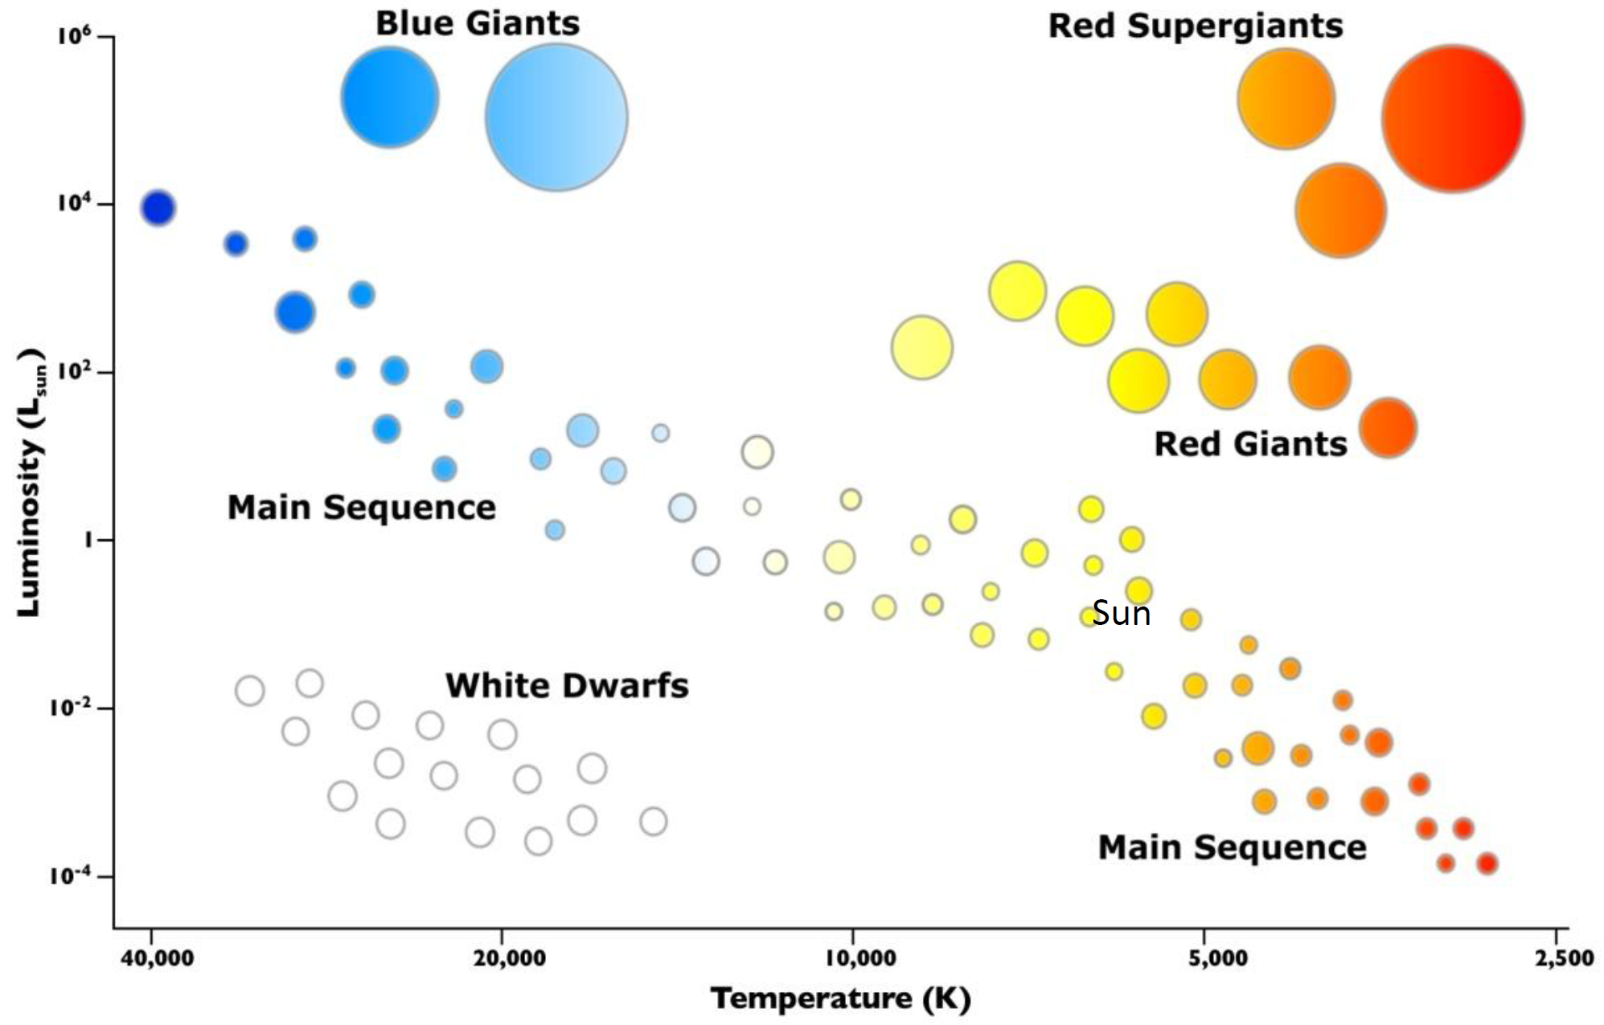
HR Diagram

Slide 5
Understanding HR Diagrams
Luminosity, intrinsic brightness, and absolute magnitude refer to_______________________________________.
Apparent brightness refers to ____________________________________________ from where it’s viewed.
Our sun has a luminosity of ____ and all other stars are compared to that.
Star temperatures are measured in ________________. _______K – Water freezes; ______K – Water boils; ____K – atoms stop moving

Slide 6
Sixty Symbols
Watch the YouTube video “Star Classification: Sixty Symbols”.
Answer the following questions:
What is the official classification for our Sun?
What is the current letter classification (from blue to red)? What is the mnemonic used to remember it?

Slide 7
Visiting Our Star Neighbours
The nearest star system to ours is _______________ at a distance of _____________________.
It consists of three stars:
Alpha Centauri A
Alpha Centauri B
_______________________
The first two are main sequence stars that orbit each other. They appear to the naked eye as one star.
The third is a red dwarf that probably orbits the other two.
Alpha Centauri B is orbited by its own planet.

Slide 8
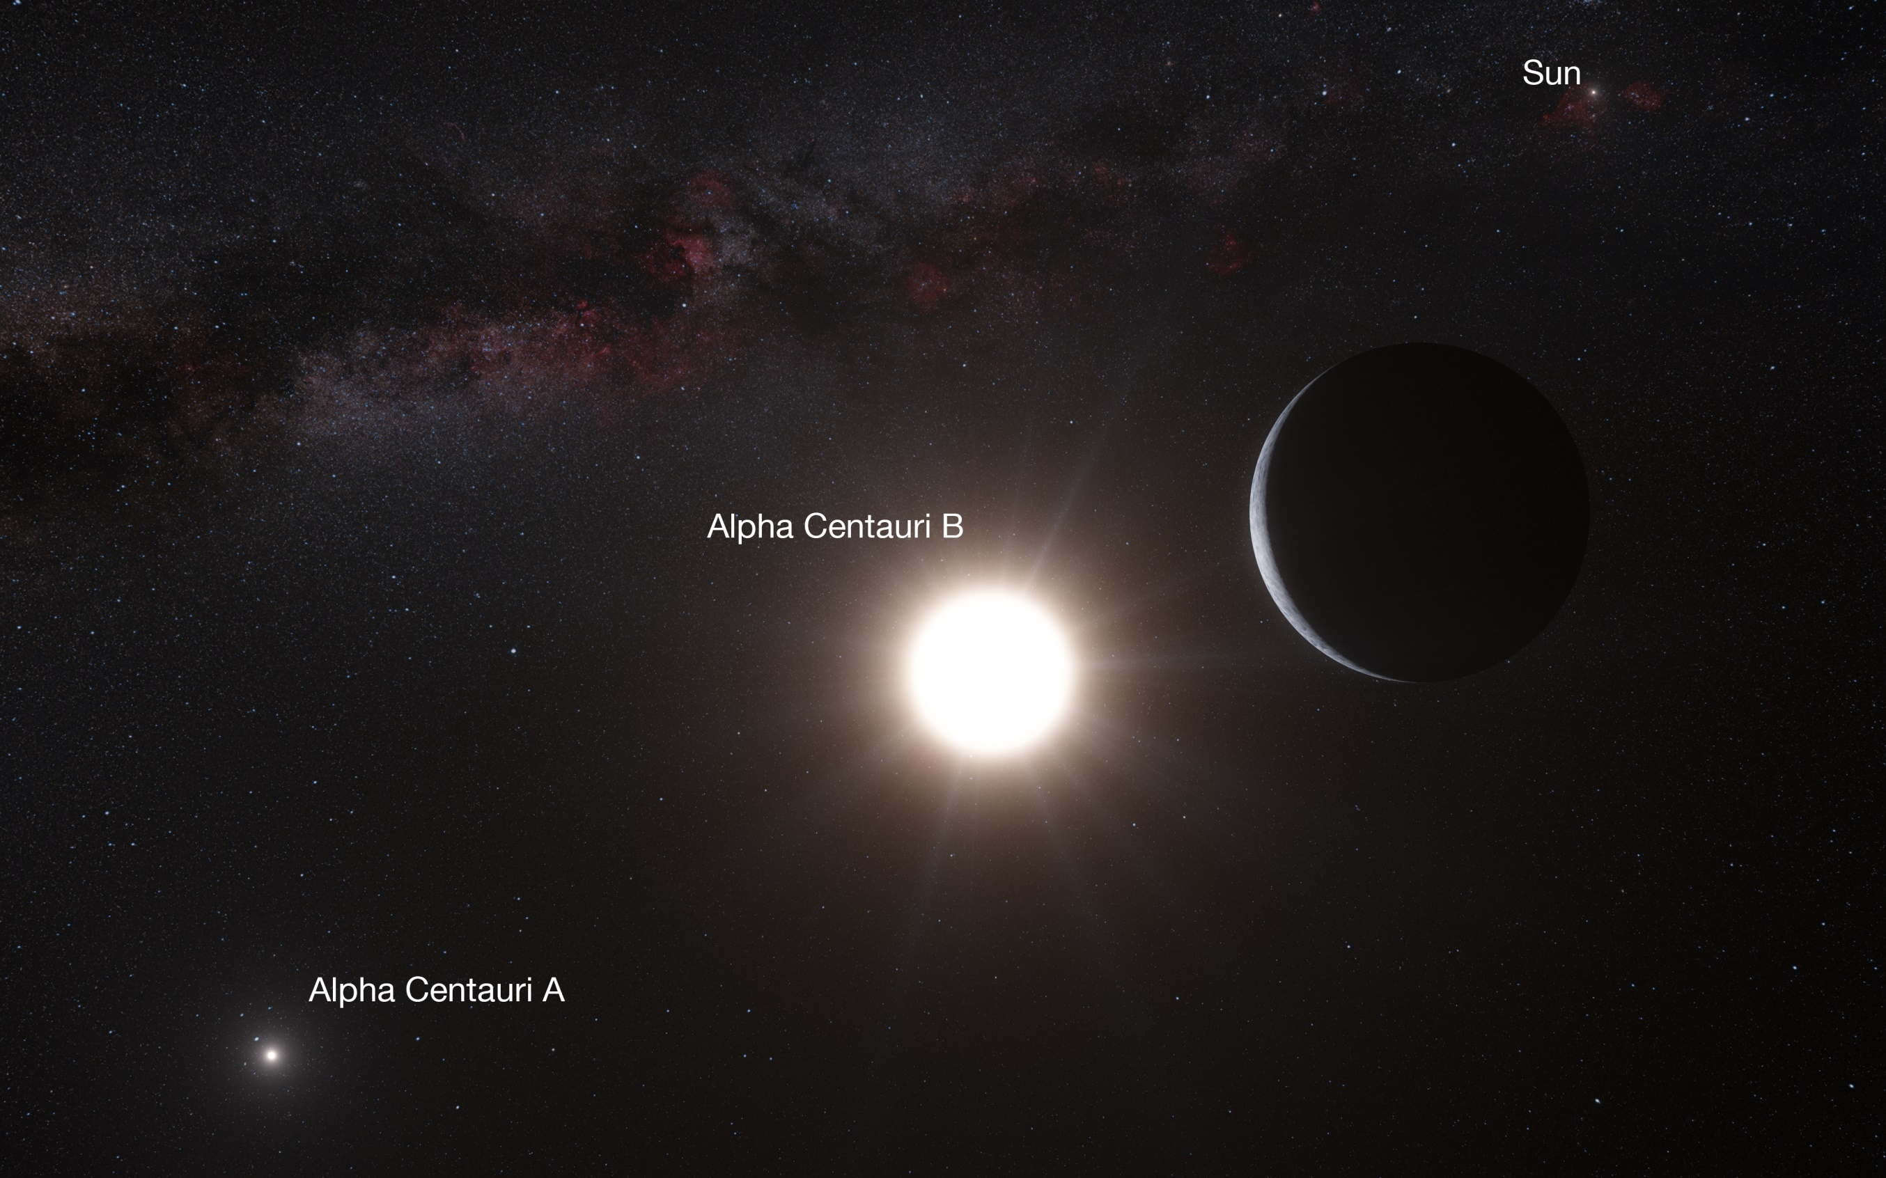

Slide 9
Can We Get to Alpha Centauri?
Watch the YouTube Video “Can We Get to Alpha Centauri”.
Answer the following question:
What are some problems with sending a space probe to Alpha centauri?

Slide 10
What Other Stars are Close To Us?
Watch YouTube video “Big Bang Theory – Sheldon lists the nearest stars”.

